Slide 1


E-Commerce Website Using WordPress

Slide 2
plugins install:
Akismet Anti-Spam
Contact Form 7
Editors Kit
Elementor
Facebook for WooCommerce
Google Listings and Ads
Mailchimp for WooCommerce
WooCommerce
WooCommerce Shipping & Tax
WooCommerce Stripe Gateway
YITH Slider for page builders
YITH WooCommerce Product Slider Carousel
YITH WooCommerce Wishlist

Slide 3
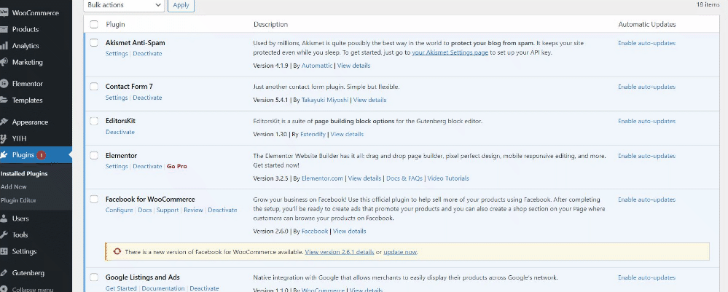
Plugins

Slide 4

Home page

Slide 5
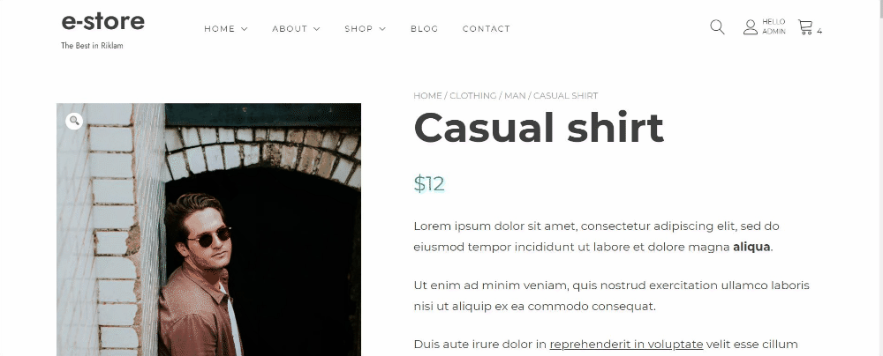
Product page

Slide 6
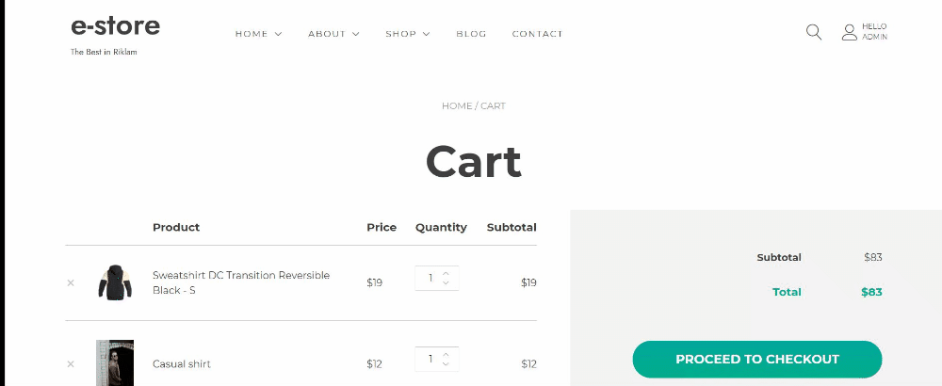
Cart

Slide 7
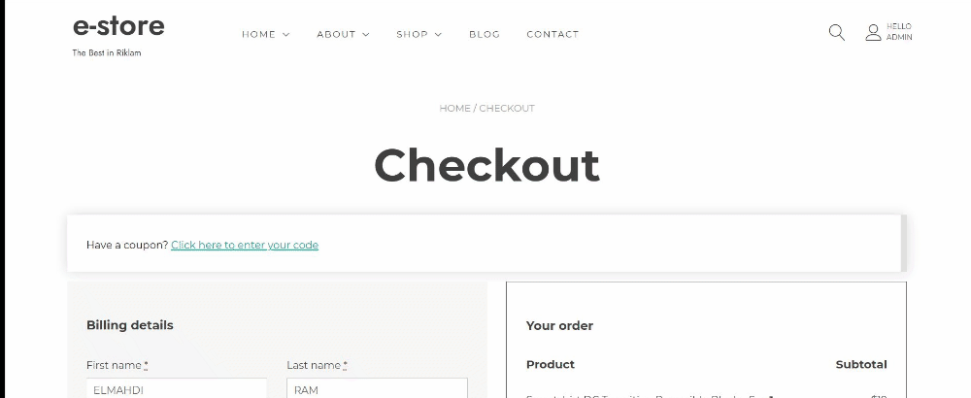
Checkout

Slide 8
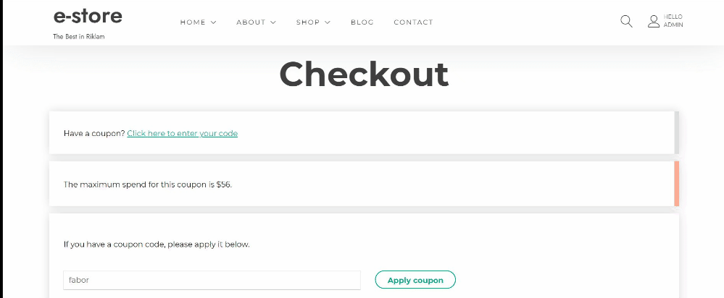

Slide 9
